Slide 1





Self-Tracking and Everyday Interaction with Personal Intelligences
Presented By: Team Caffeine
1

Slide 2

Proposal Exploration ~ 1
"SmartLife: Personal Intelligence & Health Tracker"
2

Slide 3



What is “SmartLife”?
AI-powered self-tracking app for optimizing daily routines.
Provides personalized insights on diet, exercise, stress, productivity, and sleep.
Helps users make informed lifestyle adjustments for improved well-being and efficiency.
3

Slide 4
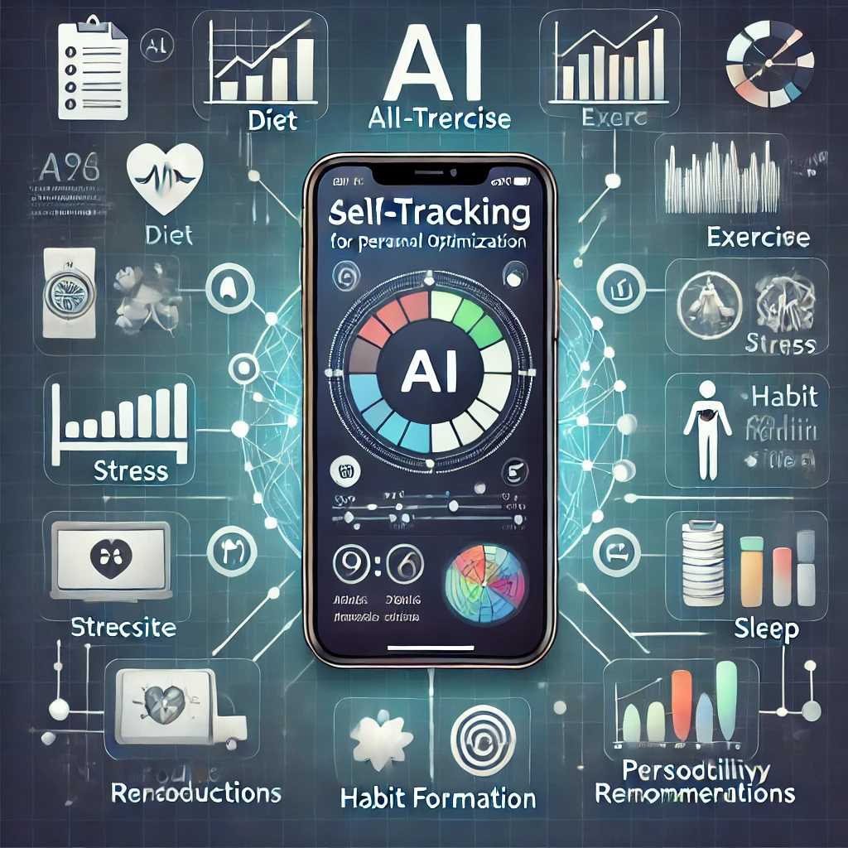

ADDING A REWARDS SYSTEM
📊 Data Tracking
🤖 AI Analysis
💡 Personalized Suggestions
🎯 Adaptive Goal Setting
🪂 User-Friendly Interface
4

Slide 5
What is the purpose?
Helps users optimize diet, fitness, stress levels, productivity, and sleep quality.
Provides AI-driven guidance to improve overall well being and work life balance.
Transforms raw self-tracking data into meaningful, actionable insights for a healthier lifestyle.
5

Slide 6
How does it relate to the theme?
🤖 AI-Powered Optimization: Combines self-tracking
with AI intelligence for comprehensive health and
lifestyle enhancement.
📺 Beyond Visualization: Provides personalized
recommendations and behavior change strategies
instead of just displaying data.
👨‍⚕️ User Empowerment: Helps users improve physical
health, mental well-being, and daily performance
through smart tracking.
6

Slide 7
Proposal Exploration ~ 2
“IdleGenie Motto: AI for Idle Time Utilization Tracking”
7

Slide 8
How to Track Idle Time?
📱Smartphone Usage-Based Tracking: Detects aimless app
switching, inactivity, and screen unlock patterns.
👣 Environment & Motion Tracking: Uses GPS, motion
sensors, and accelerometer data to identify waiting periods.
🤖 AI-Based Pattern Recognition: Learns habits, predicts
idle moments, and adapts based on user behaviour.
8

Slide 9
How to Utilize Idle Time Effectively?
📱Productivity: Micro-learning, note-taking, and email/ task sorting.
😊 Well-Being: Meditation, posture fixes, and gratitude reflections
🪩 Entertainment: Short reads, mini-games, and music or podcasts.
📲 Social Engagement: Quick messages, forum interactions, and
random acts of kindness
9

Slide 10
AI Features & Personalization
📋 Adaptive Suggestions: AI refines recommendations
based on past behaviour.
😊 User Preferences & Mood Detection: Context aware
activity suggestions.
🎮 Gamification: Rewards users for making good
use of idle time.
10

Slide 11
Proposal Exploration ~ 3
"FlowTrack" Detection for Tiny Distractions
11

Slide 12
How to Track Micro-Distractions?
`
📌 Passive Behavioral Tracking
🔺 Gaze Tracking (Webcam)
🔺 Typing & Cursor Activity
🔺 Phone Pickup & Notification Response
📌 Physiological Tracking (Advanced)
🔺 Heart Rate & Stress Detection
🔺 EEG Brainwave Analysis
12

Slide 13
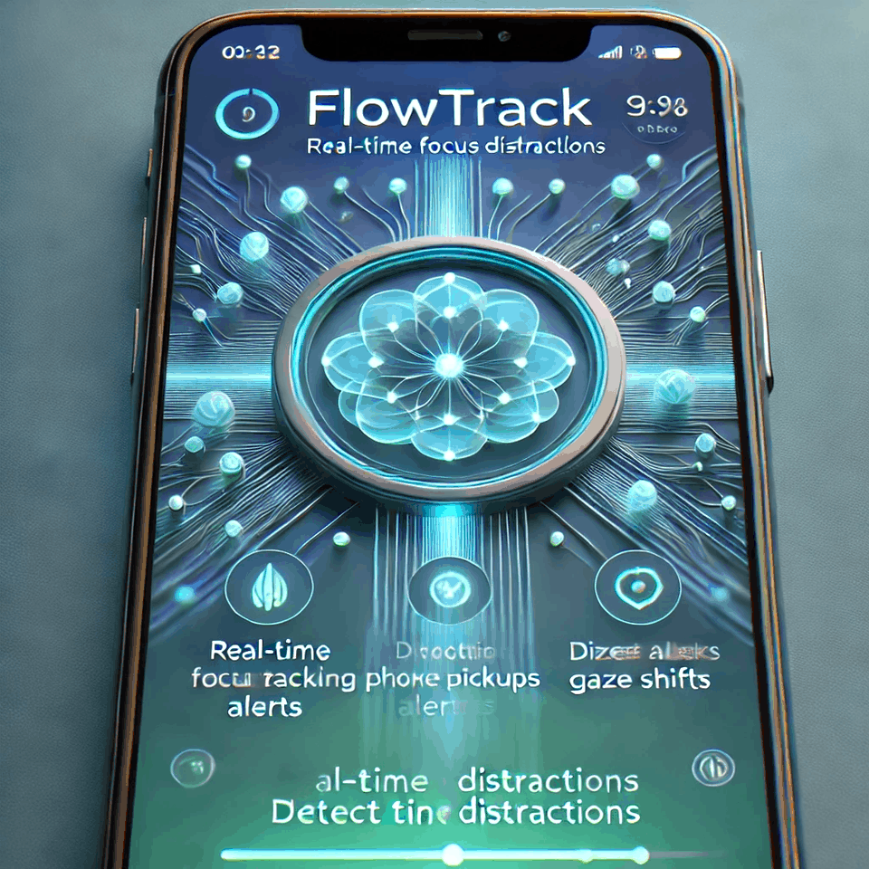
How to Use Tracked Data?
📊 Attention Pattern Analysis – Identifies when and why distractions happen
🤖 Smart Workflow Adjustments – Suggestions like batch notifications and focus reminders.
13

Slide 14
Implementation Strategy
🔴 Phase 1: MVP (Basic Tracking)- Implement gaze
tracking, typing pauses, and phone pickups.
🔴 Phase 2: AI Insights & Adjustments- Introduce
pattern recognition and notification batching.
🔴 Phase 3: Wearable Integration & Advanced AI- Add
heart rate monitoring and adaptive distraction blocking.
14

Slide 15

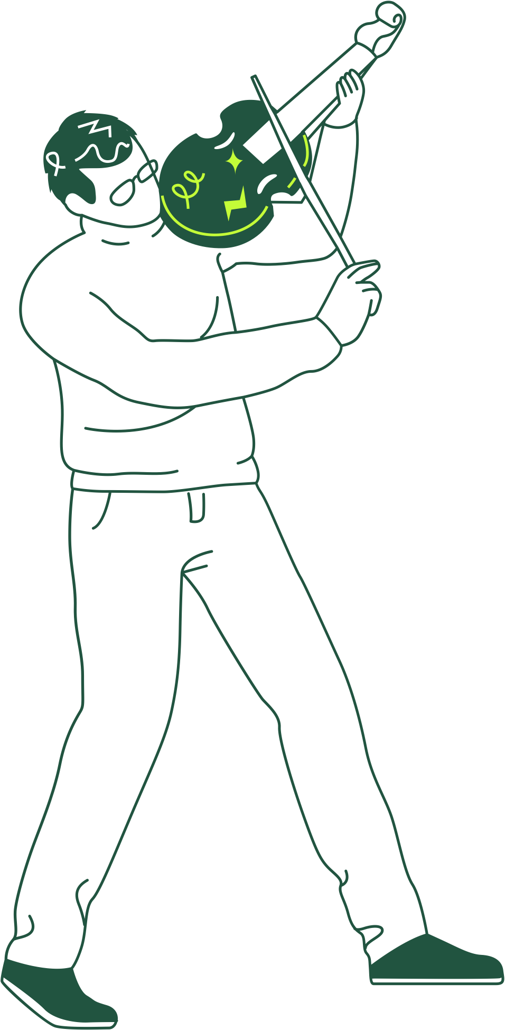
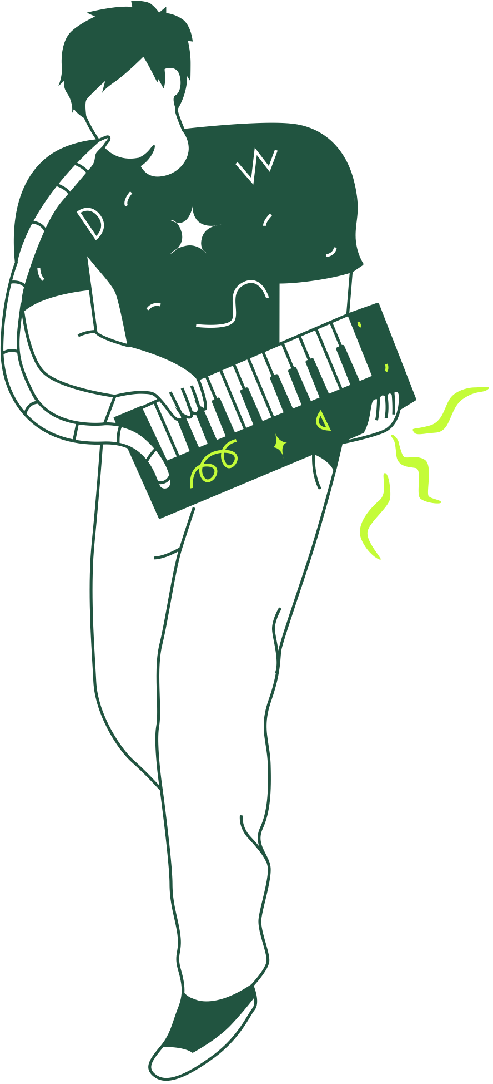
Thank You!
15

